Slide 1
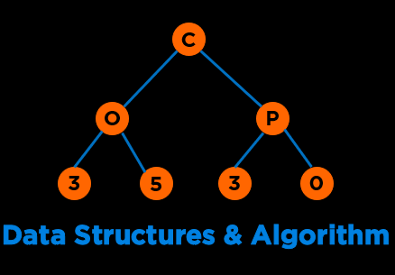
Data Structures & Algorithms
COP 3530 : Fall 2021

Slide 2












About Me: Amanpreet Kapoor
Educator
CS Education Researcher
Mentor
Software Engineer
Ph.D. Student
Lifelong Learner
kapooramanpreet@ufl.edu
Notes:
My name is Aman and I will be your instructor for this course
I wear many hats and identify myself as a
Some of the organ…

Slide 3
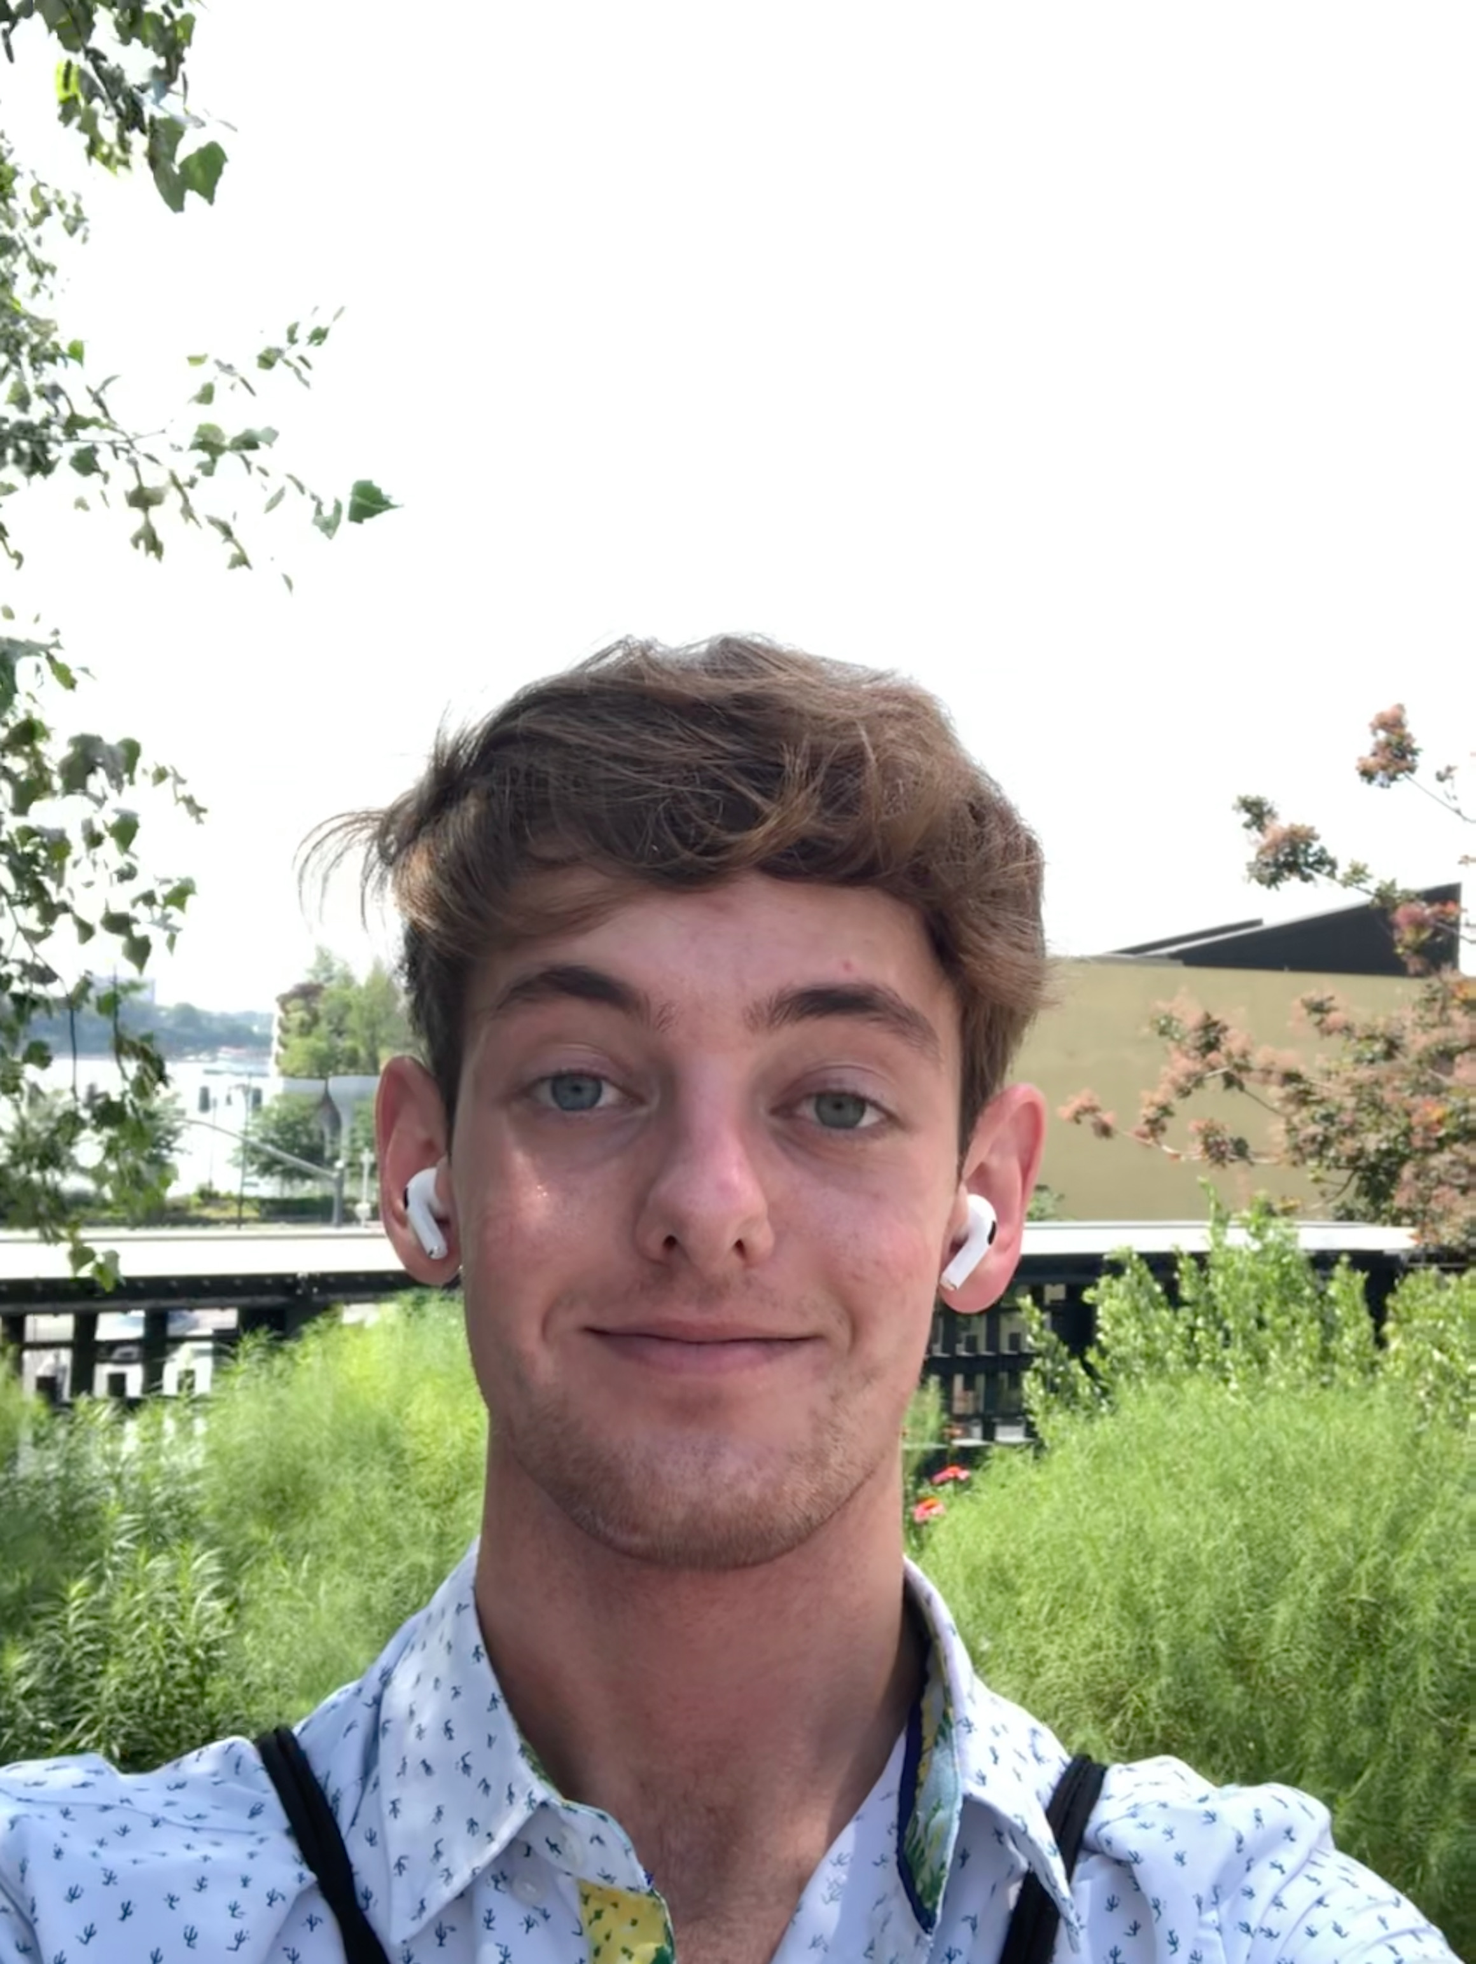
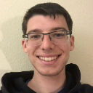
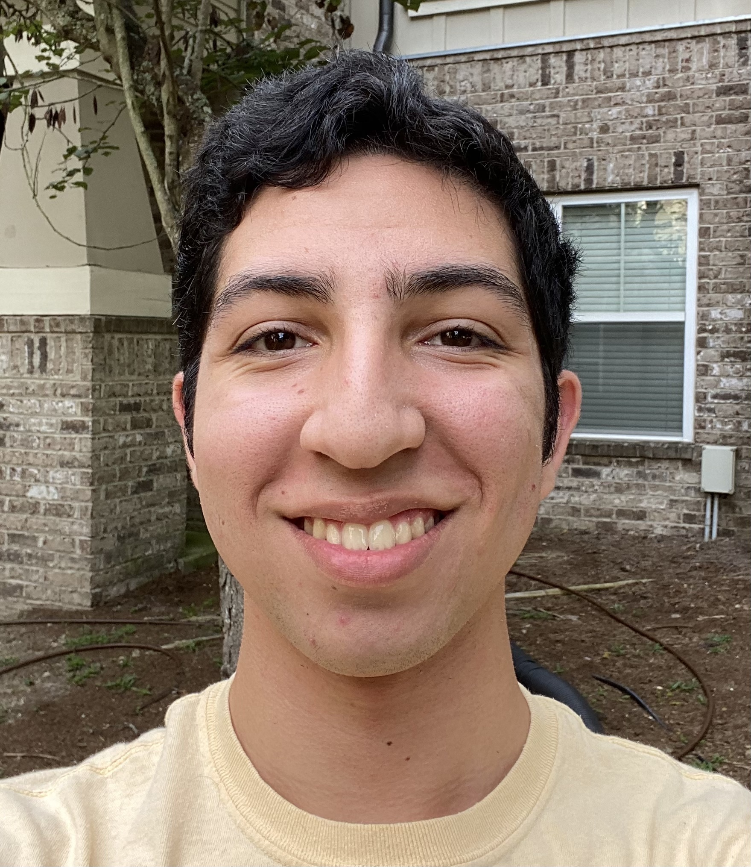
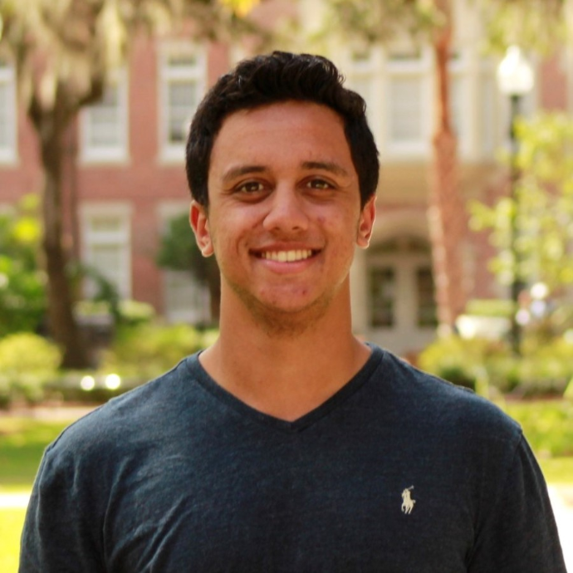


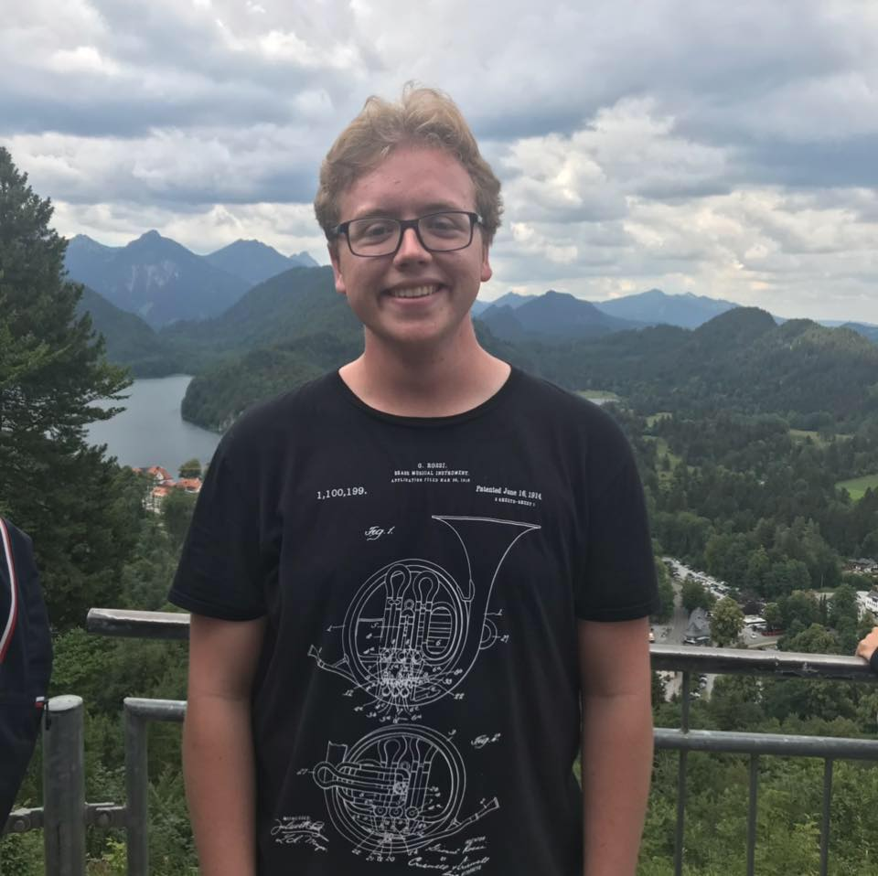
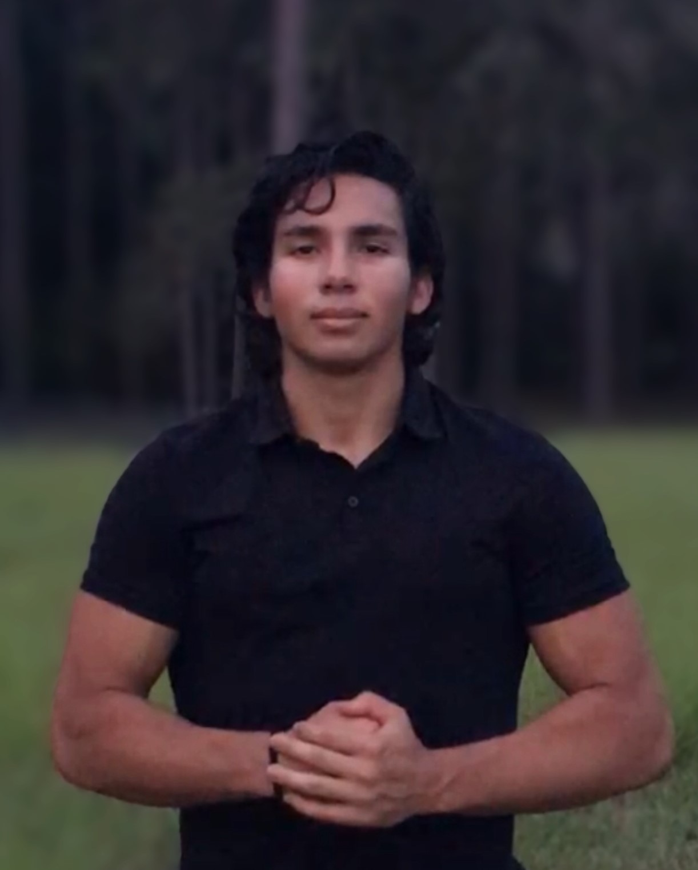
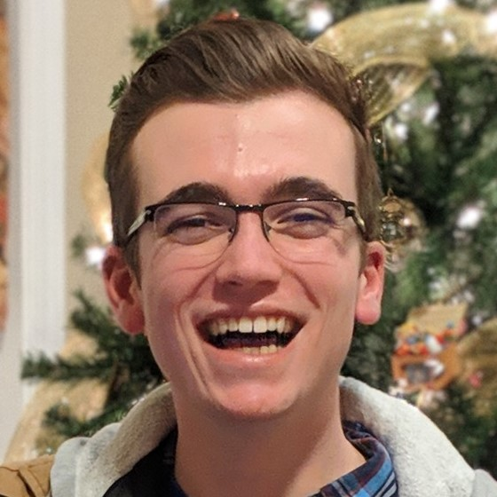
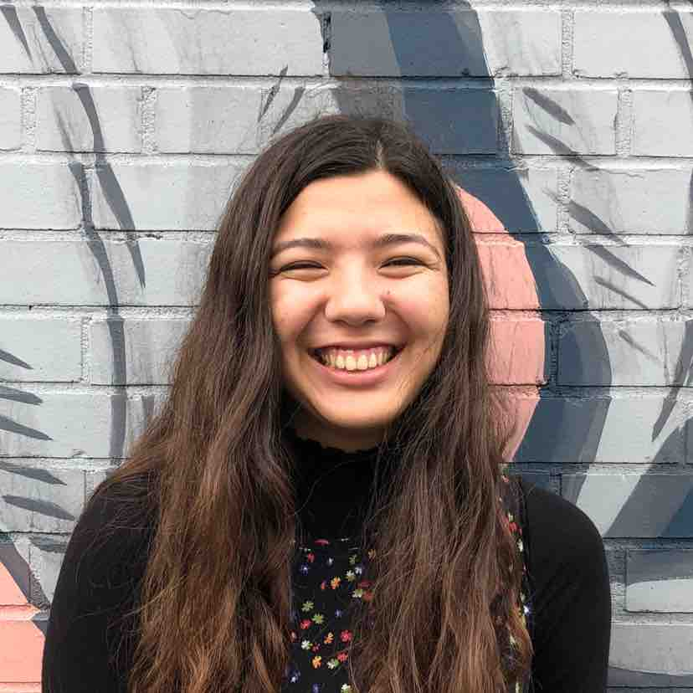
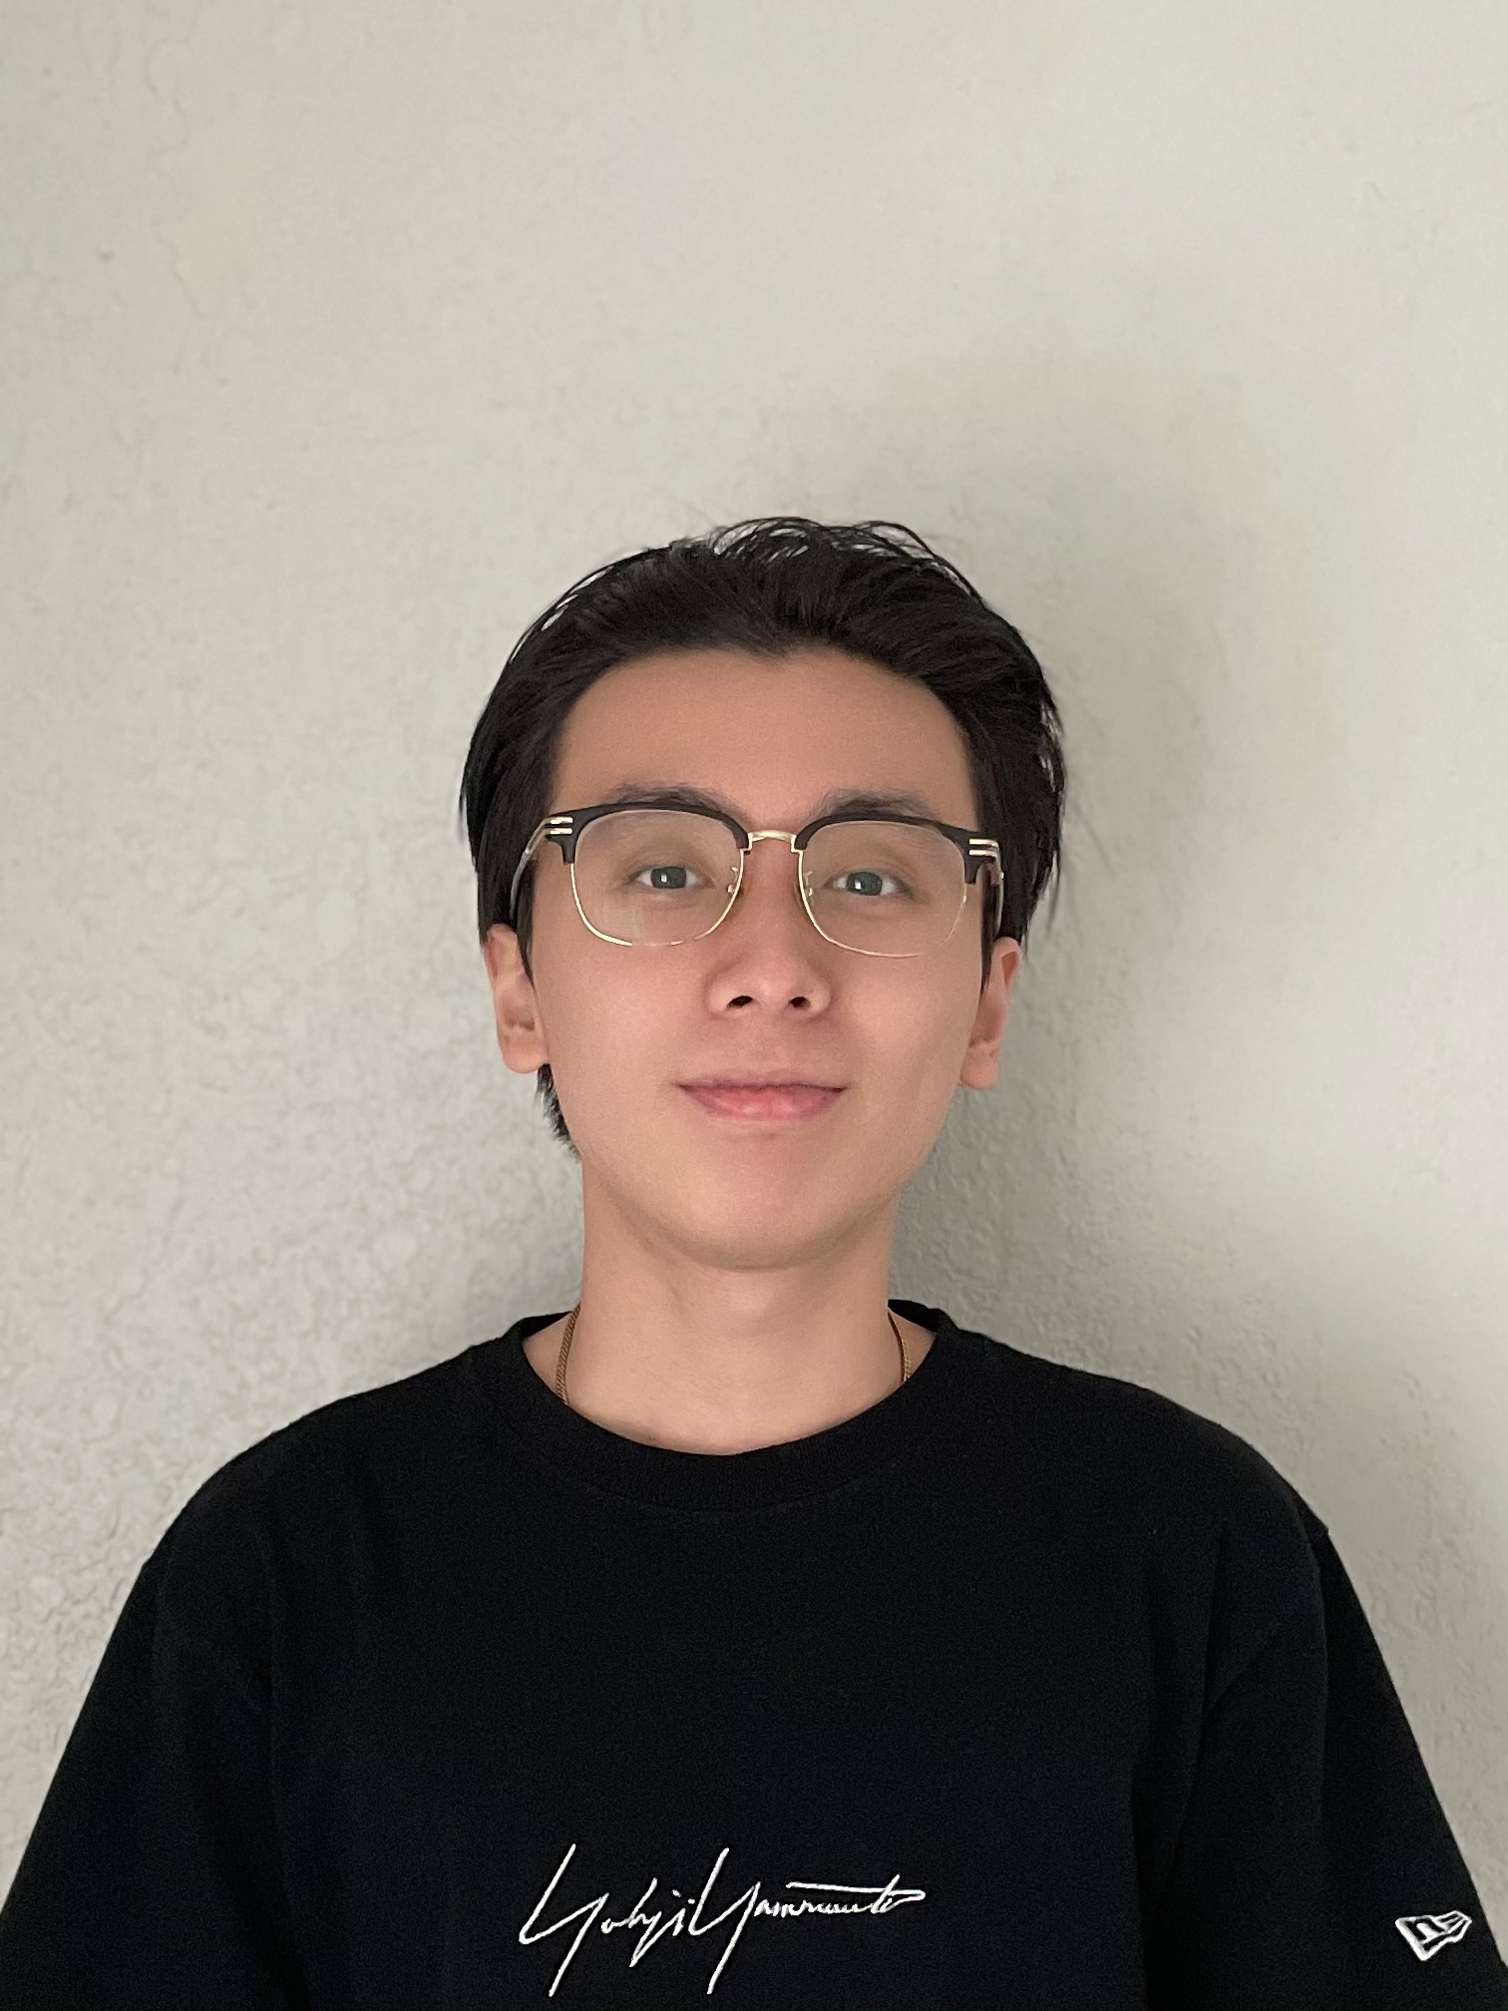
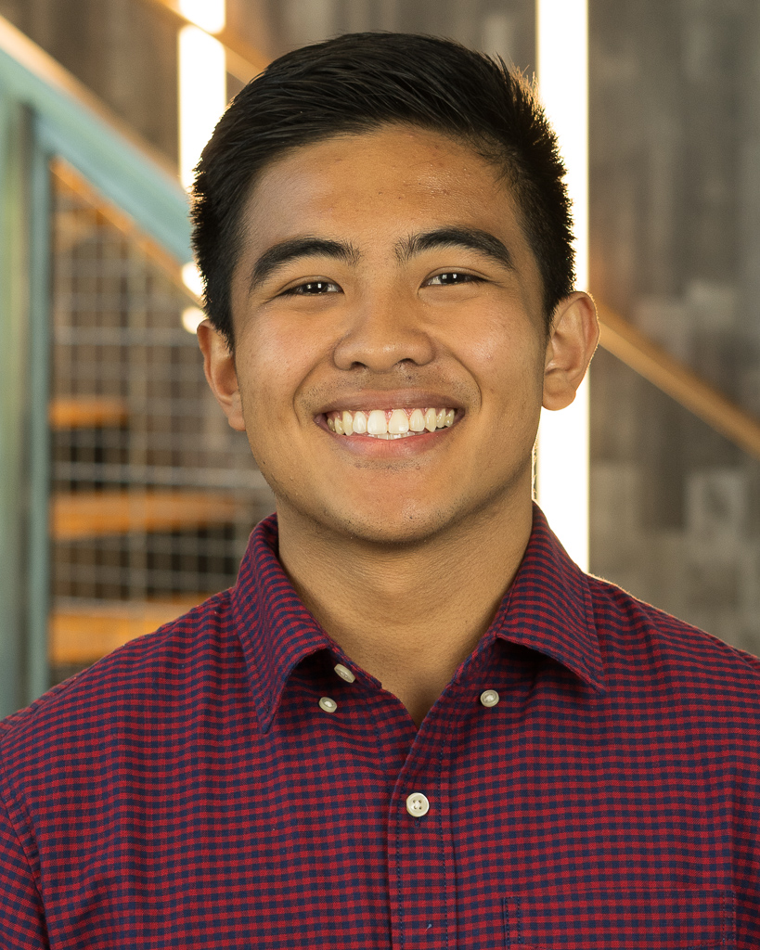
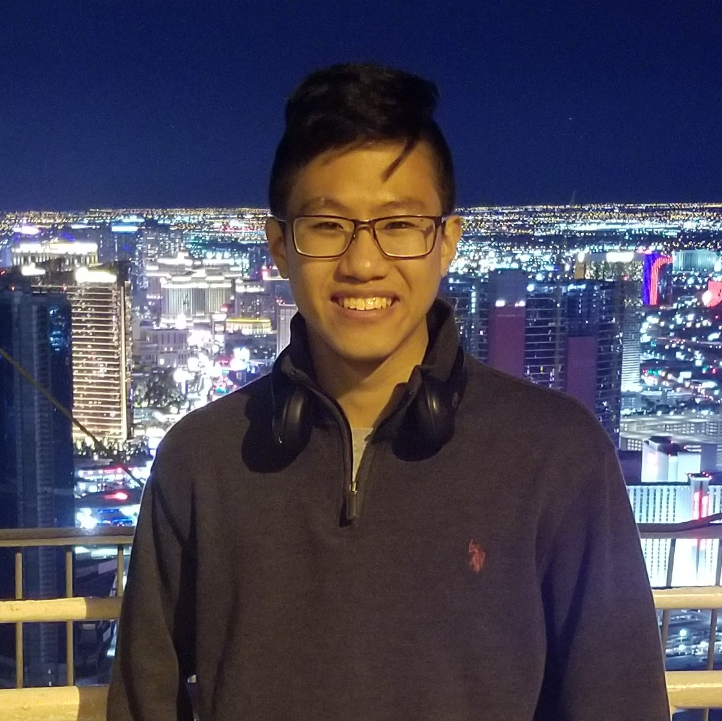
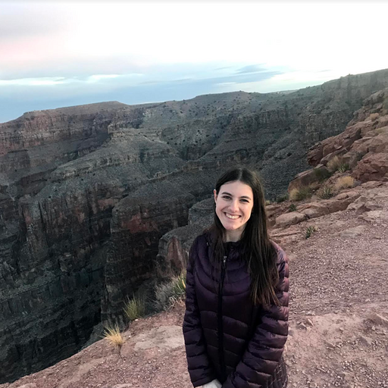
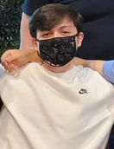
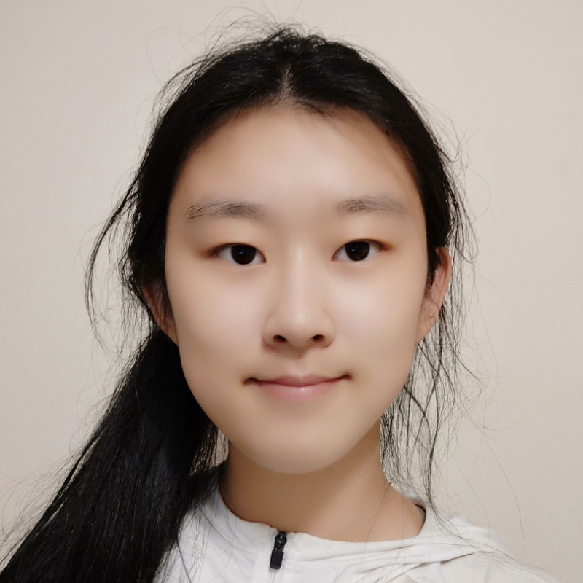
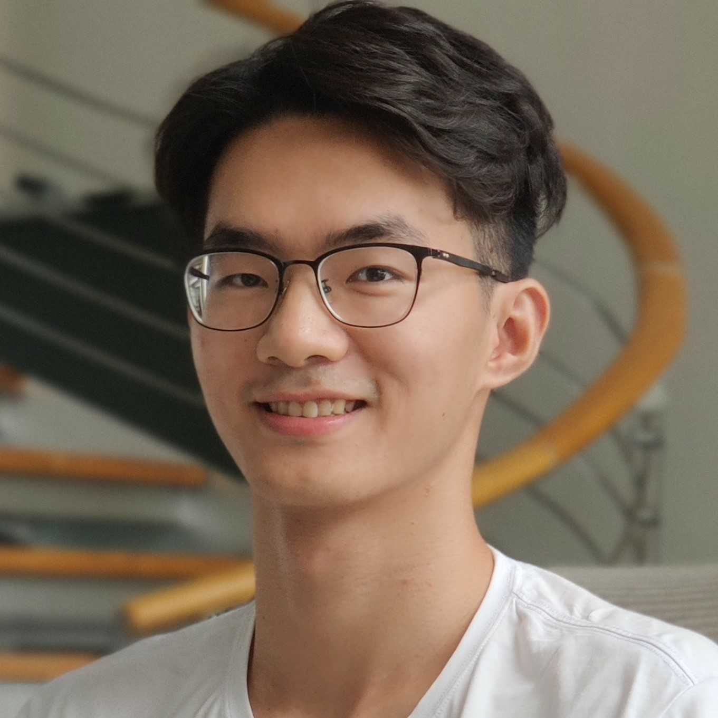
Course Staff
Alex
Andrew
Andrew
Dhruv
Dom
Dustin
Hamish
Jahdiel
Josh
Katie
Kunyao
Marc
Paul
Robin
Rob
Victoria
Xiao

Slide 4

Learners: Let’s Get to Know You
Go To Menti.com
Code: 6873 9177

Slide 5
Course Objectives

Slide 6
What is this Course About?
This course covers algorithm development using
pseudo languages
basic program structures
program design techniques
storage and manipulation of basic data structures
3 Credit Hours

Slide 7
What is this Course About?
Data Structures & Algorithms
Conceptual Understanding
Critical Thinking or Problem Solving
Implementation
Notes:
Psuedocode and code

Slide 8

Categories of Data Structures
Linear Ordered
Non-linear Ordered
Not Ordered
Lists
Trees
Sets
Stacks
Graphs
Tables/Maps
Queues
Notes:
Data structures are ways to collect data. There are basic categories of data structures:

Slide 9

Categories of Algorithms
Brute Force
Divide & Conquer
Greedy
Dynamic Programming
Selection Sort
Binary Search
Minimum Spanning Tree
Knapsack
Bubble Sort
Merge Sort
Shortest Paths
Fibonacci
Insertion Sort
Quick Sort
NP Complete Problems
Notes:
We will be talking about various DS and Algo

Slide 10
Logistics & Policies
Notes:
But what do we truly care about?

Slide 11






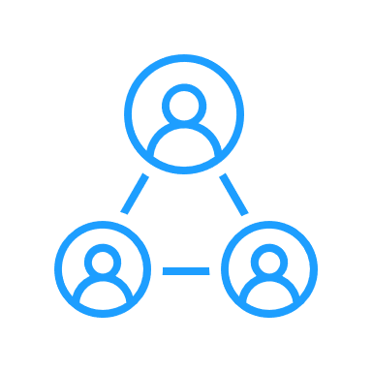
Format
Action Items by Monday morning
Optional: Attend synchronous discussions on Zoom on Tue/Wed.
Attend or watch lectures synchronously on Tue and Thu.
Optional: Watch recorded lectures asynchronously later.
1. Quiz due on Wed
2. Stepik questions due on Sun

Slide 12
Attending Campus Lectures
You are recommended to wear approved face coverings at all times during class and within buildings even if you are vaccinated. If you are sick, stay home and self-quarantine. You could attend the lecture via zoom instead.
Those who attend should be cleared to attend campus on one.uf
Attendance is optional and you do not have to inform the Instructor or the course staff that you are not attending the campus class but instead the online lecture any day throughout the semester

Slide 13

Communication
Slack
Office Hours
Everything!
– for all question related to the course
– for communicating with peers
- one-to-one communication with me
Use Appropriate Tags
Response in < 48 business hours
Monday, (10 – 11 am) (via Zoom)
Thursday, (5 – 6 pm) (via Zoom)
By Appointment (24 hours in advance)

Slide 14

Communication
Email
Email
Fine for
Personal
Accommodations
Emergencies
Not okay for
Questions regarding logistics
Questions on coding
Fixing bugs

Slide 15



Communication
Canvas Messages
Phone Call

Slide 16
Debugging
Students should visit the course staff during scheduled office hours for help and provide context for help.
Debugging requests for projects/quiz questions must first go through the TAs or peer mentors. This is strongly encouraged given we have a large class and several of you might have similar questions.
If your problem is not fixed, then start a conversation with both the Instructor and the TA/Peer mentor who you asked for help. Debugging requests to the Instructor as a Slack direct message or an email will be ignored if you do not follow the above protocol.

Slide 17
Grading
Modality | Assignment | Weightage | % of Final Grade
Individual | Quizzes (12, Drop two lowest scores) | 2% x 10 | 20%
 | Exam 1 | 20% | 20%
 | Exam 2 (Cumulative) | 20% | 20%
 | Project 1 | 10% | 10%
 | Project 2 | 6% + 2*% +2*% | 10%
Collaborative# | Final Project (Individual or Group: 3a & 3b) | 2% + 6% + 4*% | 12%
 | Preassigned Stepik Questions (22, Drop six lowest scores) | 0.5% x 16 | 8%
Individual | Extra Credit Opportunities & Bug Bounty Program | Up to 2% | 2%
 |  |  | Total: 102%
 | * Denotes peer-graded components. 8% of your grade will be evaluated by your peers. # You are allowed to collaborate on Stepik problems, but you must cite the peer who you worked with.

Slide 18
Timeline
Week | Dates |  | Topic | Deadlines
1 | 23-Aug | 29-Aug | Algorithm Analysis
2 | 30-Aug | 5-Sep | List, Stacks, & Queues | Q_{1,} Q₂
3 | 6-Sep | 12-Sep | Trees & Traversals | Q₃
4 | 13-Sep | 19-Sep | Balanced Trees 1 | Q₄
5 | 20-Sep | 26-Sep | Balanced Trees 2 | Q₅
6 | 27-Sep | 3-Oct | Heaps & Priority Queues | Q_{H6}, P₁
7 | 4-Oct | 10-Oct | Sorting | Q₇
8 | 11-Oct | 17-Oct | Exam 1 – October 14 | E₁
9 | 18-Oct | 24-Oct | Sets, Maps, & Hashing | Q₈
10 | 25-Oct | 31-Oct | Graphs 1 | P₂
11 | 1-Nov | 7-Nov | Graphs 2 | Q_{H9}
12 | 8-Nov | 14-Nov | Greedy Algorithms | Q₁₀, P_{3a}
13 | 15-Nov | 21-Nov | Greedy Algorithms / Dynamic Programming | Q₁₁
14 | 22-Nov | 28-Nov | Dynamic Programming | Q₁₂
15 | 29-Nov | 5-Dec | Exam 2 – December 2 | E₂
16 | 6-Dec | 12-Dec | Complexity Theory | P_{3b}
Legend: Q_{N} = Quiz N, P_{N} = Project N, E_{N} = Exam N, Q_{HN} = Hire Thy Gator Quiz N

Slide 19
Programming Language
Default (Project 1 & 2, Stepik Exercises, Quizzes):
C++11
Project 3 or Final Project:
Any Language
g++ -std=c++11 your_file.cpp -o your_program

Slide 20



Tools
Compiler
G++
Stepik
IDE
OnlineGDB
Visual Studio Code
Clion
Notes:
Why Stepik: you wont have access top an ide and previously students said that it helps; iT wont get you a job but it will help you develop confidence

Slide 21
Textbook (Optional)
Data Structures and Algorithm Analysis in C++
Mark Allen Weiss
Fourth edition, 2014, ISBN 9780132847377
OpenDSA Book
https://opendsa-server.cs.vt.edu/OpenDSA/Books/Everything/html/index.html

Slide 22
Feedback
COP 3530 Feedback Form
Bug Bounty Program : Upto 1% EC in Range 0.2-1% per Bug
Quiz is not accessible due to a locked module
Typo in one of the quizzes/project descriptions
Incorrect solution in a certain test case
An accessibility bug such as no headings in documents for screen-readers
the algorithm has an off-by-one error

Slide 23
Expectations
We want you to focus on
Correctness
Clean, readable, tested, and documented code
Secondary focus on optimization
The course will not cover
Mathematical Proofs
Design Patterns
Competitive Programming

Slide 24
Academic Dishonesty
Quiz questions on Stepik, Quiz questions on Canvas, and Exams:
Work independently
No discussion at the conceptual level
You are allowed to
discuss solutions after the due date and late days have passed.
search for C++ syntax or refer to definitions of standard functions in the C++ library. For example, using the documentation listed here is fine: https://www.cplusplus.com/reference/ or https://en.cppreference.com/w/

Slide 25
Academic Dishonesty
Project 1 and 2:
Work independently
Discussion at the conceptual level is fine if you are stuck with no sharing/viewing of code
You are allowed to
discuss conceptually without discussing any code with a peer provided you cite the peer with who you discussed it. Such discussions should be held on a whiteboard using explanation figures/pseudo-codes or through talking.
discuss solutions after the due date and late days have passed.
search for C++ syntax or refer to definitions of standard functions in the C++ library. For example, using the documentation listed here is fine: https://www.cplusplus.com/reference/ or https://en.cppreference.com/w/

Slide 26
Academic Dishonesty
Project 3, Stepik weekly assigned questions, and Stepik ungraded questions:
It is fine to collaborate with peers. You must make sure you are not blindly copy-pasting another student’s code. Also, you must cite the peer you worked with at the code level or conceptually.

Slide 27
Academic Dishonesty
Sharing/copying, “borrowing” of code structure, looking at code from another student or providing such code, and plagiarism, in addition to other dishonest behaviors, are all considered to be academic dishonesty.
No information regarding the project 1 and 2, quiz, and exam solutions may be shared by students. We strongly encourage that if you have doubts, visit the course staff in-office hours. Looking at any piece of your peer’s code, sharing files, searching for solutions found online, or using someone else to code your solution is strictly prohibited.
Penalty
zero on that assignment and a two-letter final grade decrement for a first offense
E grade for second offence
For both offenses, you will be reported to the Honor Court

Slide 28
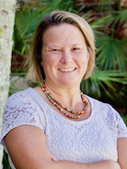
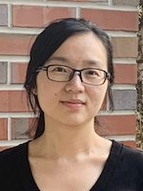
Acknowledgements
Cheryl Resch
Lecturer,
Dept. of Engineering Education,
University of Florida
Lisha Zhou
Lecturer,
Dept. of Engineering Education,
University of Florida

Slide 29
References
Books/Notes
Dr. Sartaj Sahni
Dr. James Aspen
Dr. Mark Weiss
OpenDSA
Dr. Cathy Hughes
Videos Authority
Dr. Josh Hug
MIT OCW 6.006: Dr. Erik Demaine and Dr. Srini Devadas
Dr. Robert Sedgewick
Videos Youtube
HackerRank: Data Structures
HackerRank: Algorithms
Back To Back SWE
MyCodeSchool
Abdul Bari
GeeksforGeeks

Slide 30
Walkthrough

Slide 31
Walkthrough
Canvas
OpenDSA
Slack
Stepik

Slide 32
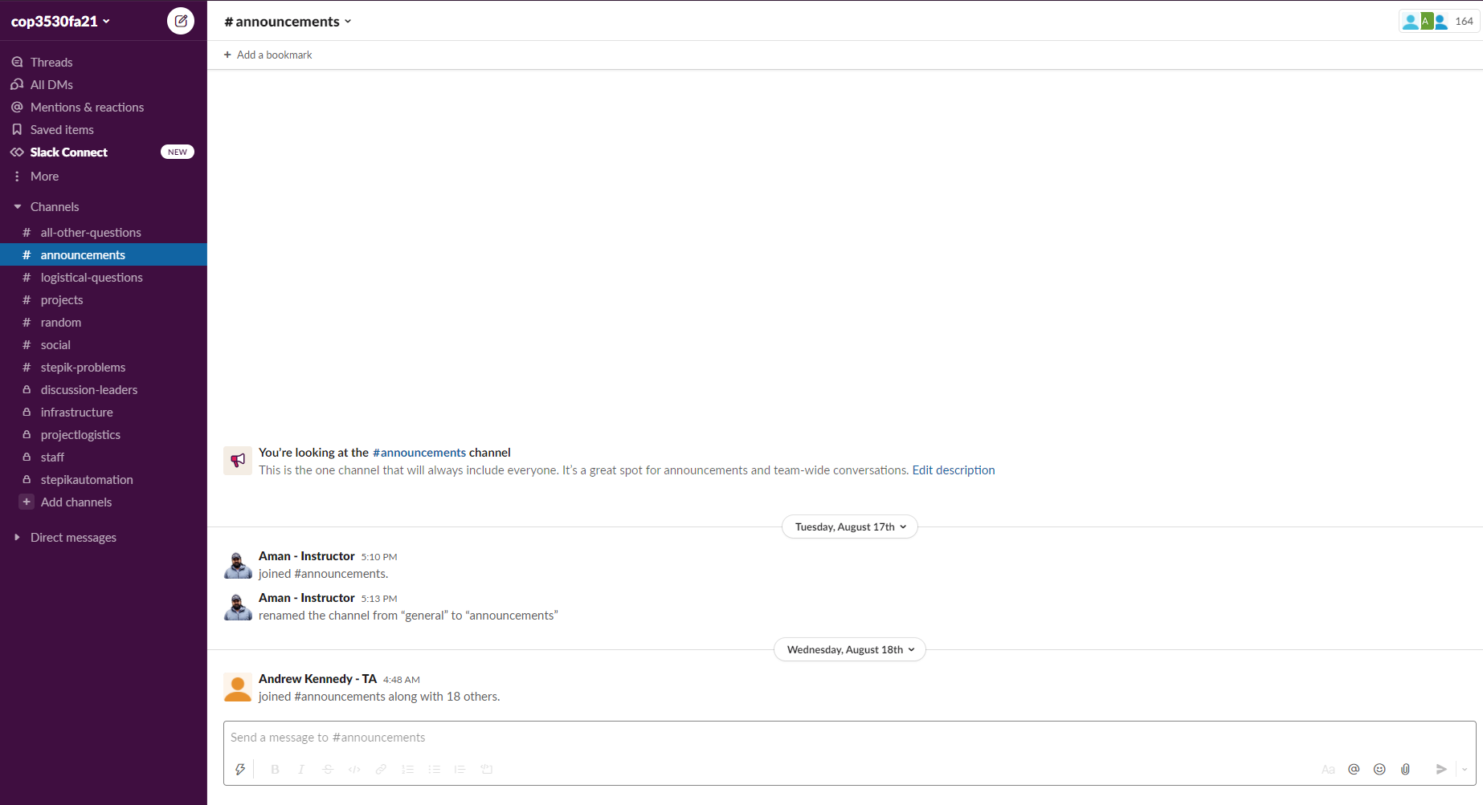
Slack

Slide 33
To Do
Notes:
But what do we truly care about?

Slide 34
Next Steps
Join Slack and greet your peers
Complete Stepik Invite Request
Complete Quiz 1Attend Discussion today/tomorrow

Slide 35
Questions

